Slide 1
SPECIALIZED ASSET MANAGEMENT (S.A.M.) LEAD-GENERATING BOT
By Miguel Correa, Richard Altema, and Jesus Saenz

Slide 2
Motivation & summary
Designed to give crypto experts, insurance brokers, real estate agents, and financial planners a source of “ready-now” clients searching for services in their specific area of expertise.
The Specialized Asset Management (S.A.M.) Bot can be deployed using marketing campaigns on YouTube, Facebook, Instagram, Tik Tok, and other online and social media platforms.
S.A.M. Bot can also be integrated into the financial professional's website.

Slide 3
Model Summary
We created a bot on Amazon Lex using Python language and AWS Landa. Natural language processing (NLP) was used to build a machine that understands and responds to text.
S.A.M. Bot is interactive, intuitive and user-friendly for consumers.
The interface collects data points such as clients name, phone number, email, and the financial service being inquired about. Also allows the consumer to select appointment date and time for consultation in their chosen financial specialty.

Slide 4
Data Cleanup, Model Training, and Model Evaluation
The exploration and cleanup process was primarily trial and error when entering utterances, responses, and deciphering the different options Amazon uses for their slots and lambda integration with the scheduler.
To ensure the bot is running as desired, you can build and test directly on the AWS website as you are designing the bot. It is important to test the bot responses in order to simulate a free-flowing dialogue between the end-user and S.A.M. Bot.

Slide 5
Discussion & postmortem
If we had additional time, we would be able to add voice recognition, design a mobile app, create a website for the bot, add additional financial services, use Sequal combined with S.A.M. BOT to allow us to gather data and provide additional use cases for the financial professionals using our services.
Training a bot is time-consuming. There are certain types of dialogue that you cannot anticipate until it is entered by the end-user. So, to say you have “every possible entry” covered is an impossibility.
To help us reach our desired goal of generating leads for our clients while still providing a smooth dialogue for the consumer, we chose to give the option to speak with a professional once certain basic data is provided.

Slide 6
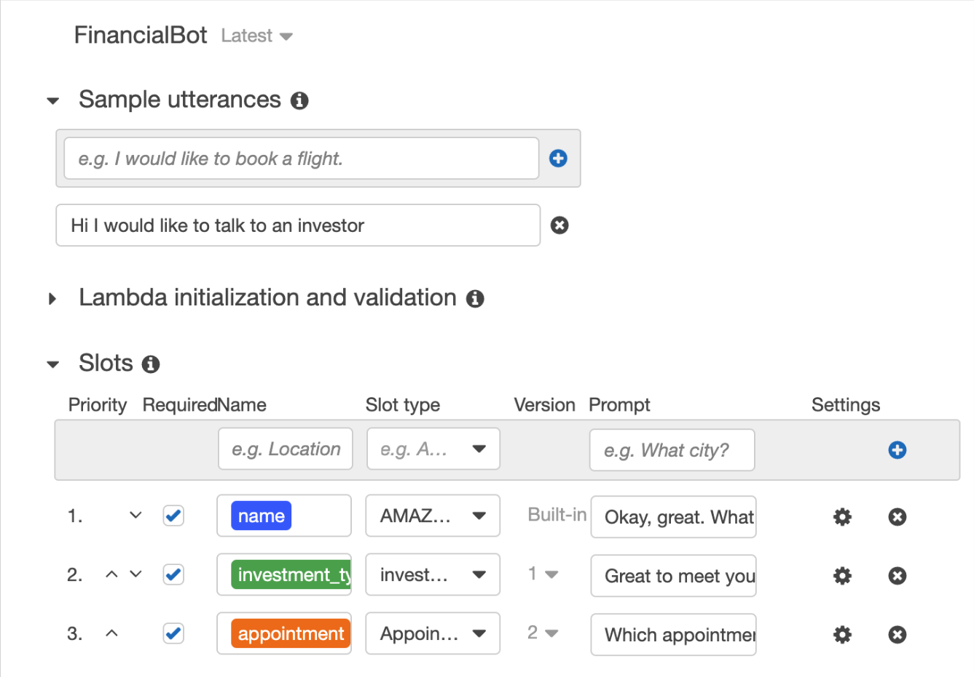

Slide 7
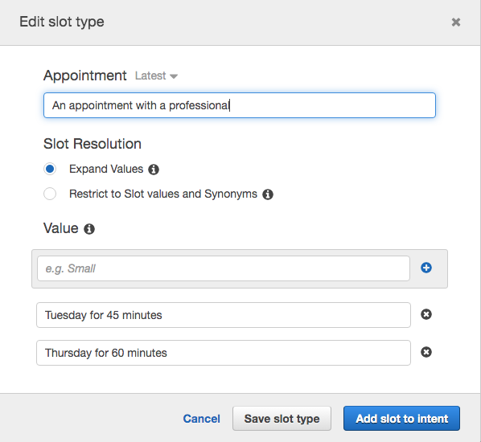

Slide 8
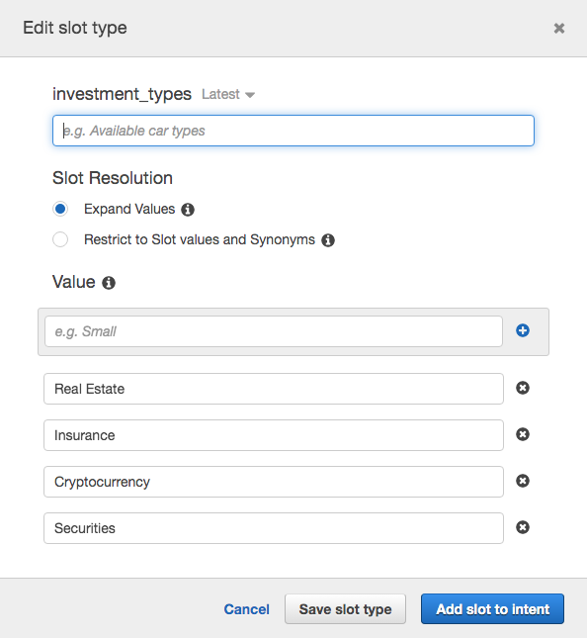

Slide 9
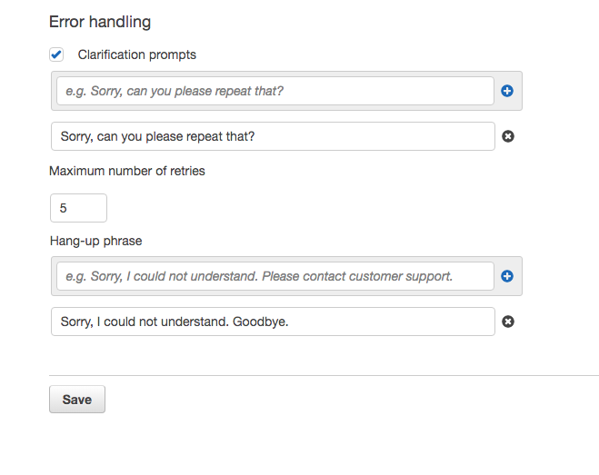

Slide 10
